Slide 1


The Way Ahead
COM Programming
Notes:
Page <number>
WNCOMPG-2 v1.5
Chapter 15, The Way Ahead

Slide 2


Chapter Overview
Objectives
  Check out what's happening in the COM world
  Put the course into perspective
  Point the way to further information
Chapter content
  What have we achieved?
  Consolidating your knowledge and experience
  Useful sources of further information
Close
Notes:
Page <number>
WNCOMPG-2 v1.5
Chapter 15, The Way Ahead

Slide 3
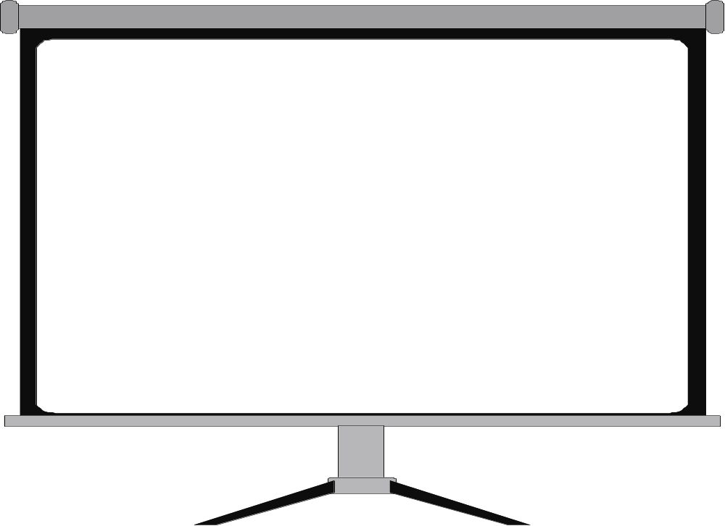
What Have We Achieved?
On completion of this course, you should be able to:
Describe the basic features of COM
Build a simple COM object from scratch
Define a COM interface using IDL
Build more-complex COM objects using ATL
Write COM clients in other languages
Implement callbacks using connection points
Appreciate the issues involved in DCOM
Describe the features of the COM+ environment
Notes:
Page <number>
WNCOMPG-2 v1.5
Chapter 15, The Way Ahead

Slide 4


What Next?
Course material
Very Small
And Small Again
class nonsense
{
public: // sector
...
private: // parts
...
};
class nonsense
{
public: // sector
...
private: // parts
...
};
Practical experience /
Internet resources
The PARTS Catalogue is the main source of Parts for your application. The Catalogue resembles a notebook control containing pages that can be accessed through the use of the tabs. There are both major and minor tabs. The major tabs are located along the right-hand side, and the minor tabs can be seen along the bottom edge. The minor tabs indicate that there are more pages for that particular major tab; there are different minor tabs for each major tab. Another way of turning through the pages, is to use the page control buttons. Notice that the page numbers change when you move between pages.
On the next slide, you will become more familiar with the Workbench, where you will see there is an information area which can contain brief help and comments. This will become apparent when you move the mouse over various Parts in the Catalogue - the information area of the Workbench will display a short description about that Part. It is also worth noting that moving the mouse over the background area of the Catalogue page will give you a description of that page.
This default Catalogue is held as a file, with a .CAT extension in the sub-directory SYSTEM of your install directory. For example, C:\PARTS\SYSTEM\PARTS.CAT
Later in the course we shall see how to customise the Catalogue, and how to create new ones. The File menu button will be used to load other catalogue files.
PARTS enables developers to work more closely with end users to build the user interface components, which can be dynamically changed as the user requirements evolve. The construction of applications from smaller components enables the developer to reuse much of the code that they have already written elsewhere, thus reducing development time, as well as the potential for introducing coding errors. PARTS also gives the developer the ability to make use of existing 3GL code (C or C++, for example) code that is packaged as a DLL.
More experienced developers can benefit from Smalltalk/V, either as a complete programming language, or as a scripting language to build further functionality into the application. On the other hand, less-experienced users can become productive very quickly. This is because PARTS is able to abstract the user from the underlying code.
Books
Consolidate existing knowledge and experience
MS2099
COM+ Application
Development
Follow on courses
Notes:
Page <number>
WNCOMPG-2 v1.5
Chapter 15, The Way Ahead

Slide 5
Advances in C++ / ATL
Visual C++.NET
  Delivers attribute support directly to C++
  Removes the necessity for IDL
ATL 7
  General class improvements
    There's even a wrapper for the SafeArray!
  The CComModule / CExeModule functionality has been revamped
ATL Server 7
  For writing ISAPI extensions or Web Services using ATL technologies
Notes:
Page <number>
WNCOMPG-2 v1.5
Chapter 15, The Way Ahead

Slide 6


Check out some of these COM Books
Inside COM
  Dale Rogerson, Microsoft Press, 1997, ISBN 1572313498
Inside Distributed COM
  Guy Eddon and Henry Eddon, Microsoft Press, 1998, ISBN 157231849X
ATL COM Programmer's Reference
  Richard Grimes, Wrox Press, 1998, ISBN 1861002491
ATL Internals
  Chris Sells, Brent Rector, Addison Wesley, 1999, ISBN 0201695898
Essential COM
  Don Box, Addison Wesley, 1997, ISBN 0201634465
Transactional COM+
  Tim Ewald, Addison Wesley, 2001, ISBN 0201615940
Notes:
Page <number>
WNCOMPG-2 v1.5
Chapter 15, The Way Ahead

Slide 7
Where to Look on the Web
Microsoft COM Technologies
  http://www.microsoft.com/com
Microsoft Developer Network (MSDN) Online
  http://msdn.microsoft.com
World of ATL
  http://www.worldofatl.com
COM(+) Developer Resources
  http://www.widgetware.com
Notes:
Page <number>
WNCOMPG-2 v1.5
Chapter 15, The Way Ahead

Slide 8
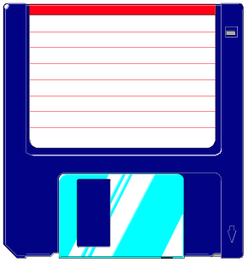
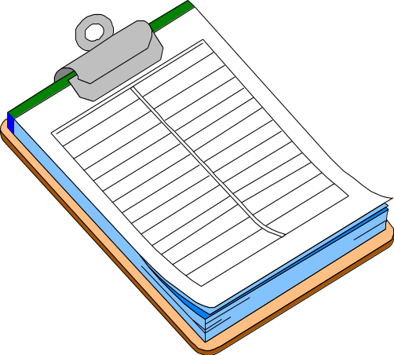

Before you go ...
Remember to make a copy
of your practicals to take
away
Please complete your
course evaluation form
and hand it to your
instructor
This is to
certify
that ...
Collect your certificate
of achievement
Notes:
Page <number>
WNCOMPG-2 v1.5
Chapter 15, The Way Ahead

